Slide 1

ASHOKA’s
TECH FOR CHANGE
CHALLENGE

Slide 2
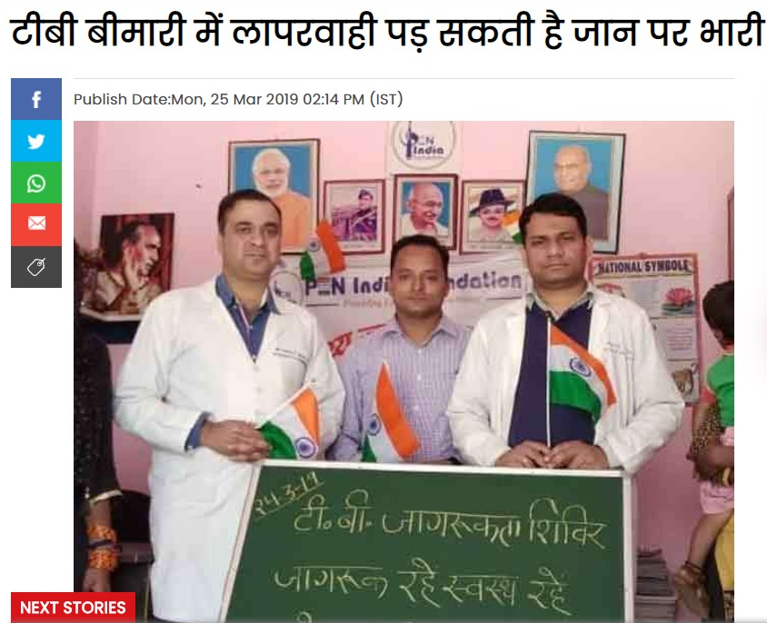
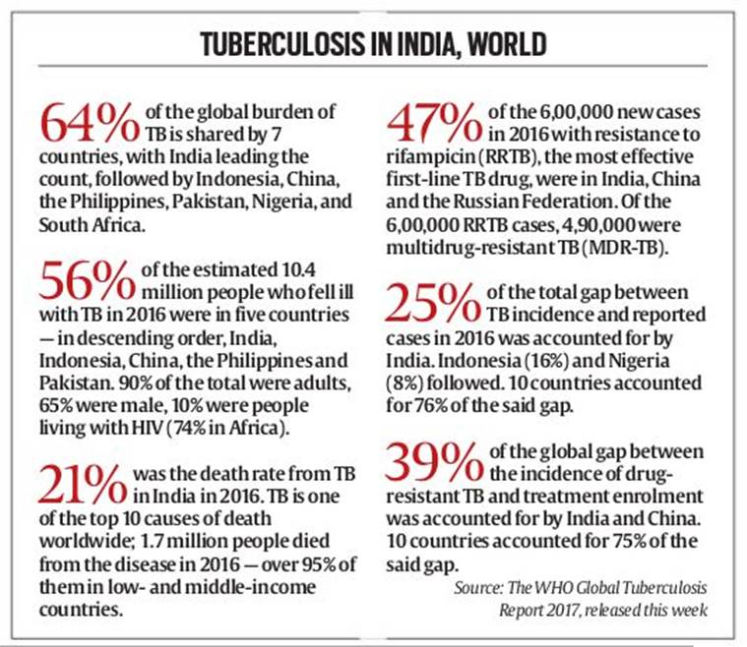
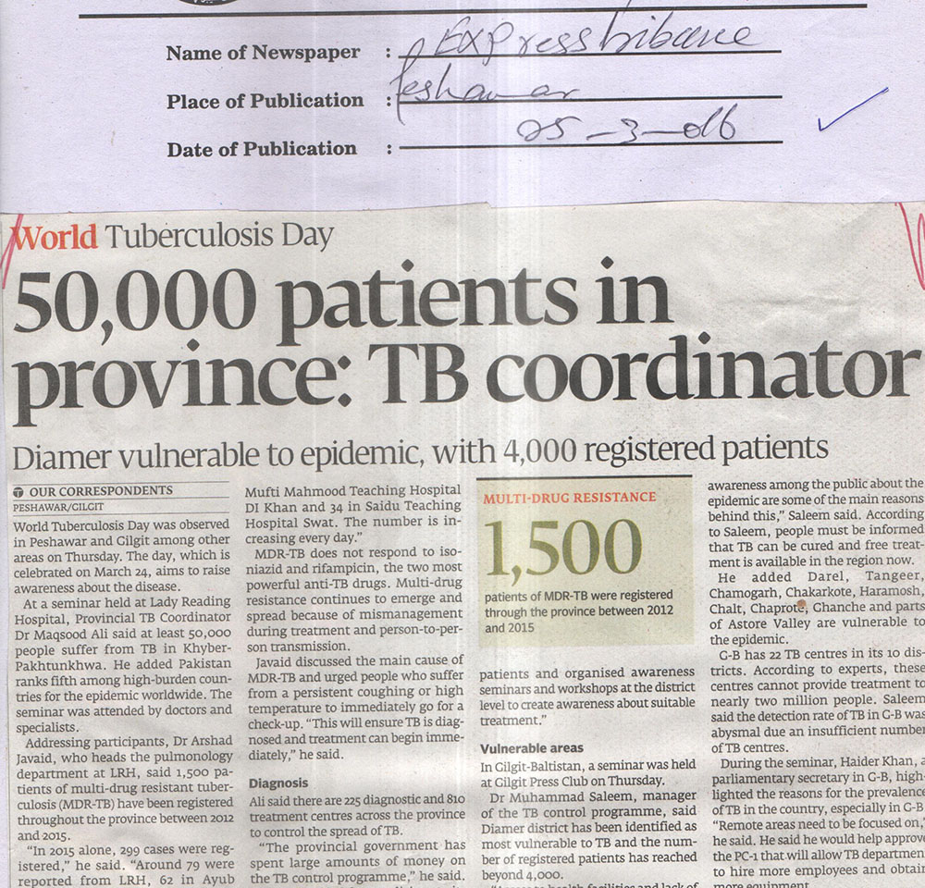
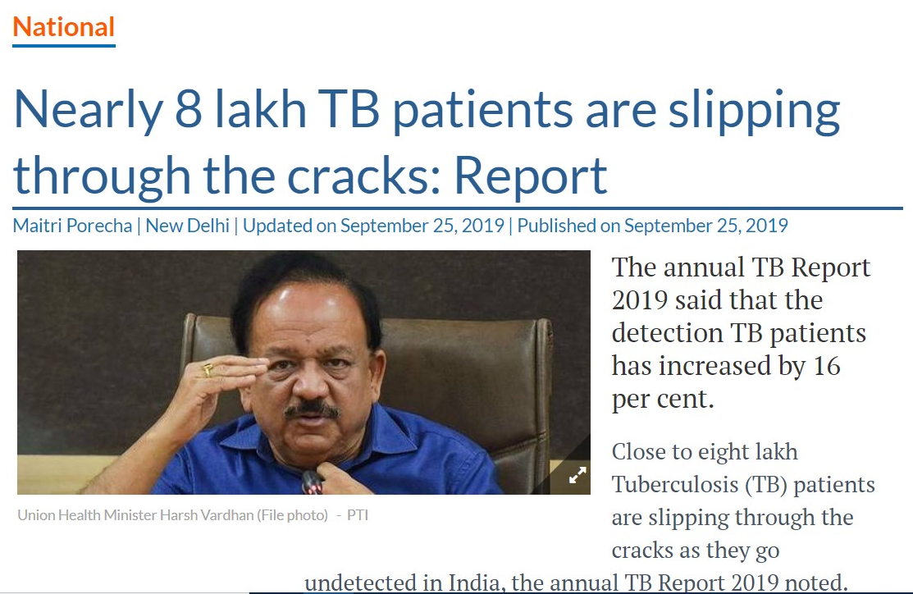
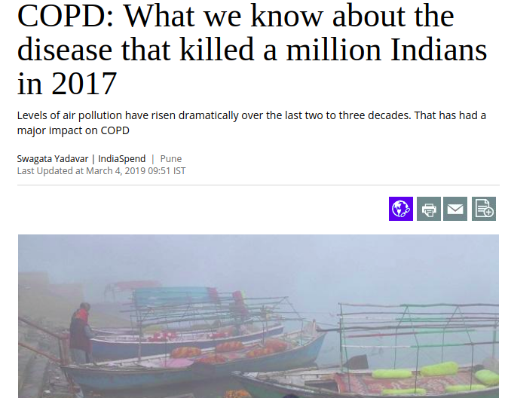
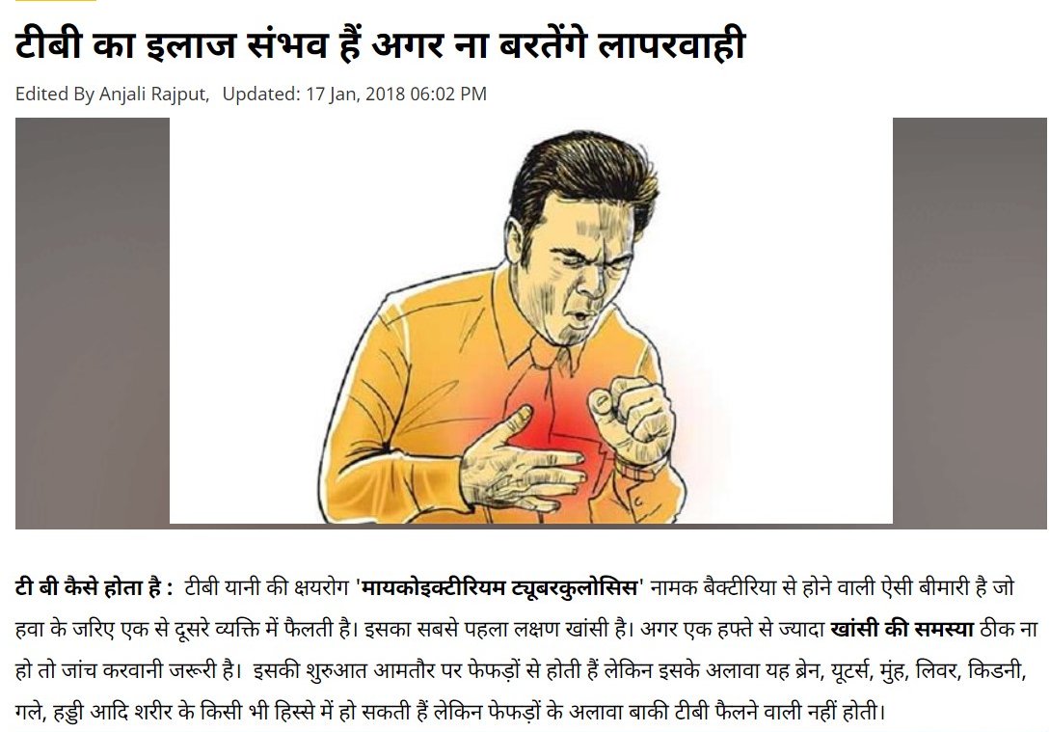
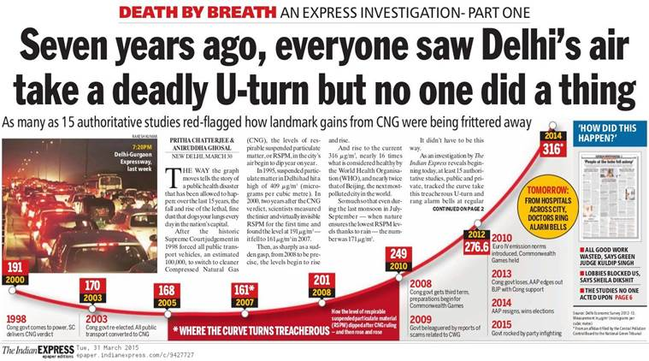
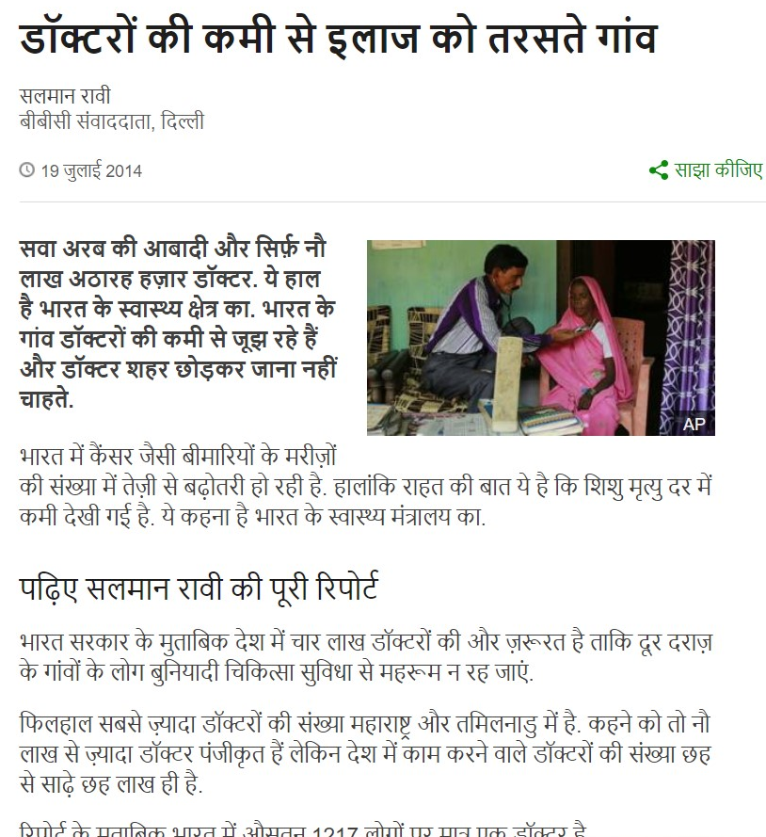
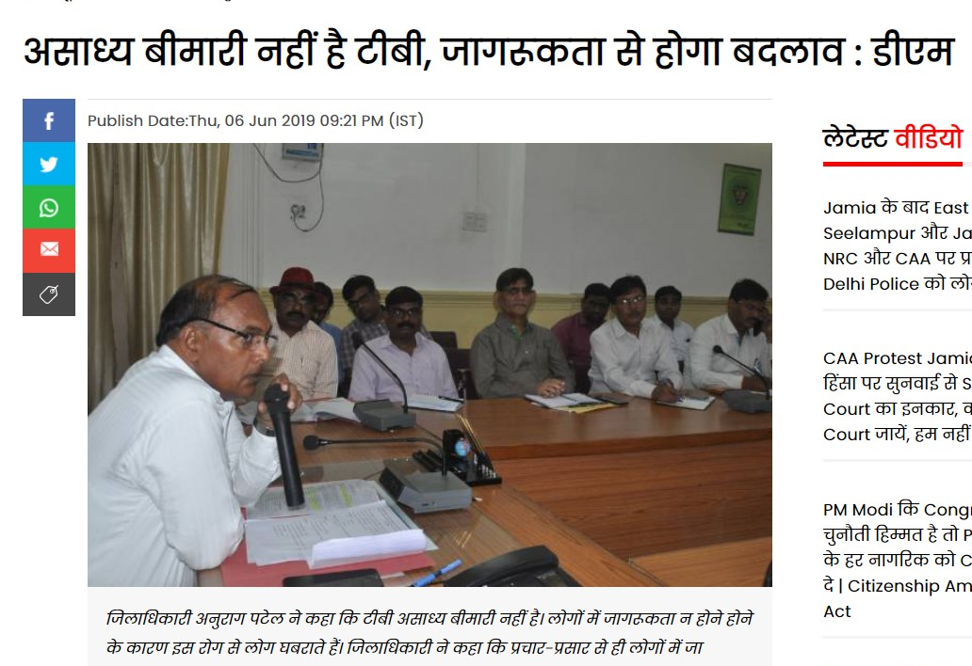
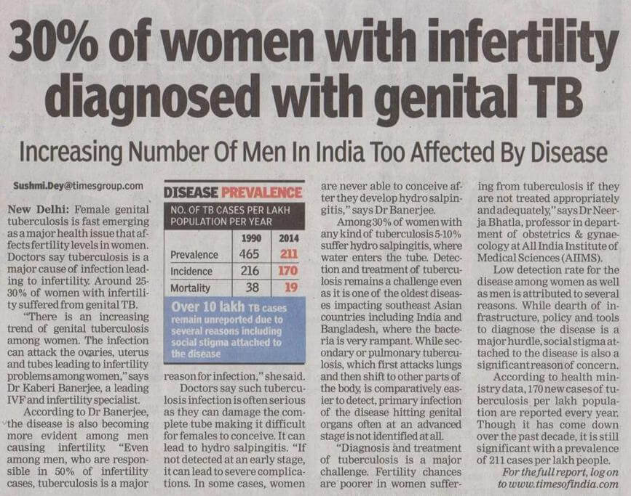
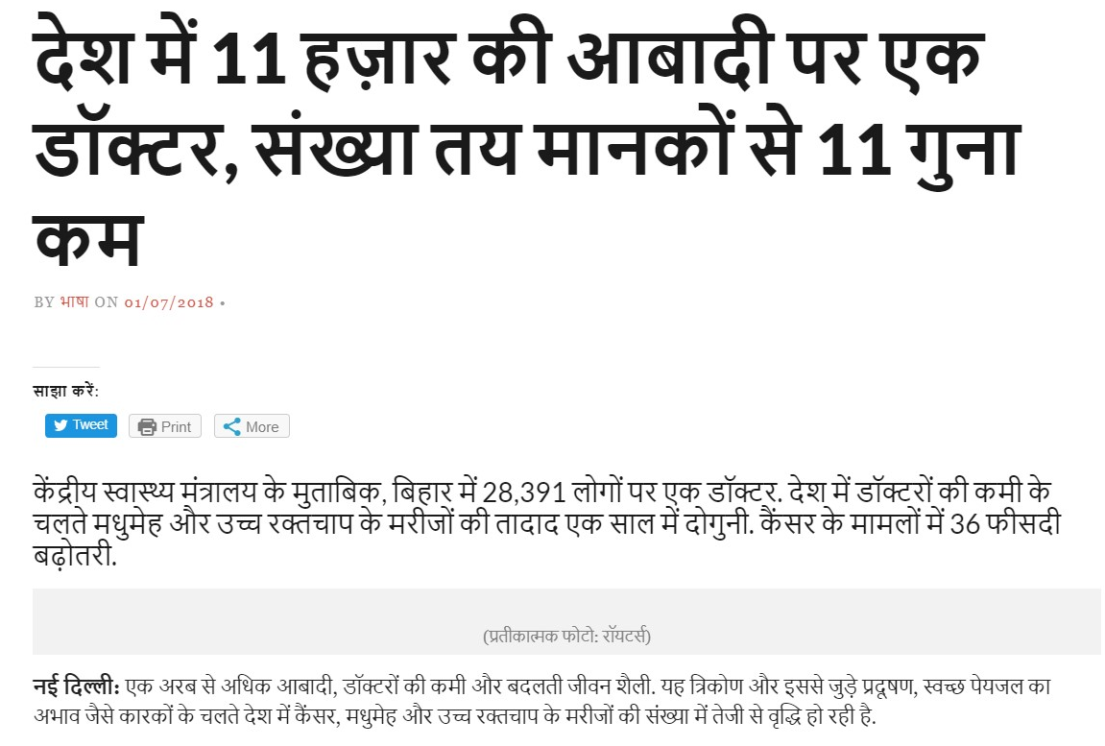
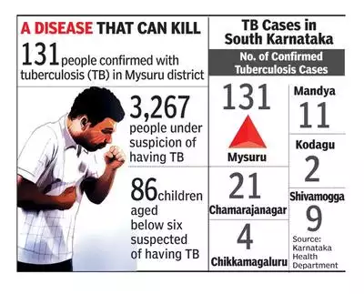

Slide 3
The Problem

Slide 4
Lack of Facilities and Infrastructure
65% medical expenditure in India is out-of-pocket, pushing 57 million people into poverty each year.
According to a report in Economic Times in April, 2019; India faces a shortage of 600,000 doctors and 2,000,000 nurses.
Despite being the second most deadly disease in India, COPD is not screened for in mass screening campaigns due to the expensive skill and equipment required.

Slide 5
The Prevailing Problems in the Country
Discrepancy in medical services in rural and urban areas
75% of dispensaries, 60% of hospitals and 80% of doctors serve only urban areas, i.e., 28% of the Indian population.
28%
28%
Lack of Qualified Doctors
India has a doctor to patient ratio of 0.77:1000 lower than the WHO recommended standard of 1:1000.*
77%
Lack of timely diagnosis
74% of severe asthma cases could have been prevented by prior diagnosis.
74%
*According to National Health Profile 2018.

Slide 6
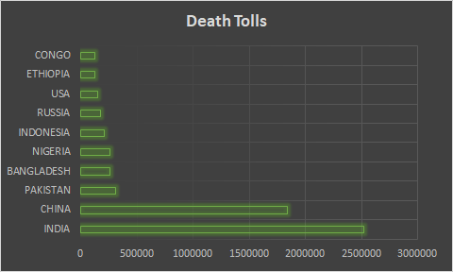
Lung Disease in India
High prevalence due to increasing pollution and extensive use of unconventional forms of tobacco.
6% of children in India suffer from Asthma.*
~25% of global deaths due to TB are in India.**
13% of deaths in India are from COPD, second highest just after heart diseases. Moreover, COPD can also lead to Lung Cancer.
*2018 Global Asthma Report ** HIV-associated tuberculosis on the rise :India TB Report
**
Death tolls per year in various countries

Slide 7
Current Screening Methods and their Problems
01
Barely implemented
Used to monitor chronic lung conditions
Test may trigger severe breathing problems
Spirometry
02
Results require at least 48 hours
Skin Test (PPD Test)
03
High Cost
Highly complex
Requires a lot of laboratory apparatus
Blood Test

Slide 8
Current Screening Methods and their Problems
01
Barely implemented
Used to monitor chronic lung conditions
Test may trigger severe breathing problems
Spirometry
02
Results require at least 48 hours
Skin Test (PPD Test)
03
High Cost
Highly complex
Requires a lot of laboratory apparatus
Blood Test

Slide 9
Current Screening Methods and their Problems
01
Barely implemented
Used to monitor chronic lung conditions
Test may trigger severe breathing problems
Spirometry
02
Results require at least 48 hours
Skin Test (PPD Test)
03
High Cost
Highly complex
Requires a lot of laboratory apparatus
Blood Test

Slide 10

Preliminary Detection
of
Pulmonary Diseases

Slide 11
Our Aim
A non-invasive, cheap and practical screening device that can be used by common public for various pulmonary diseases like Tuberculosis, COPD, URTI, Bronchiolitis, Bronchitis.

Slide 12
The Solution

Slide 13
Idea
Input
Processing
Output
Lung Sounds
+
Breathing Pattern
Audio Processing Unit
+
Machine Learning Model
Health condition of patient
Notes:
The very procedure used by doctors, used without doctors

Slide 14
Workflow
Prototype
Hardware
Software
Digital Stethoscope
Accelerometer
Convolutional Neural Network Framework
Multiple Auscultatory Anomaly Detector

Slide 15
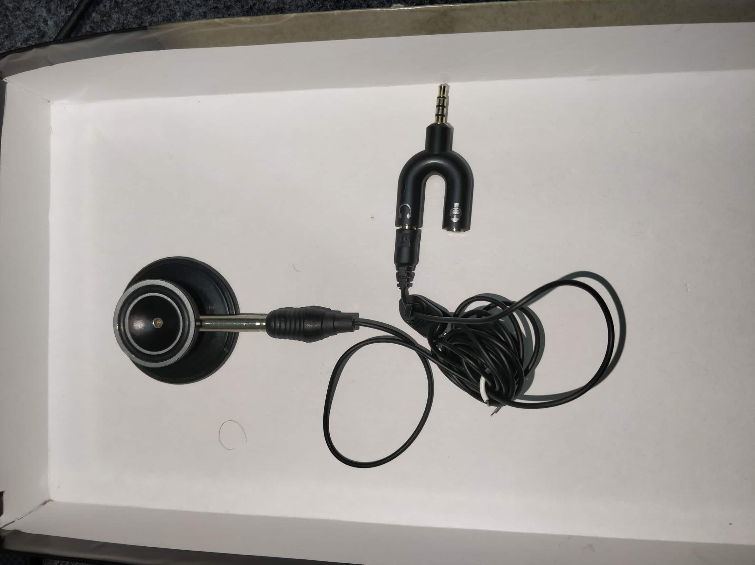



Hardware - Chestpiece
Records auscultation sounds
Chestpiece of stethoscope directly sealed with microphone for compactness
Crackles Normal Wheezes

Slide 16
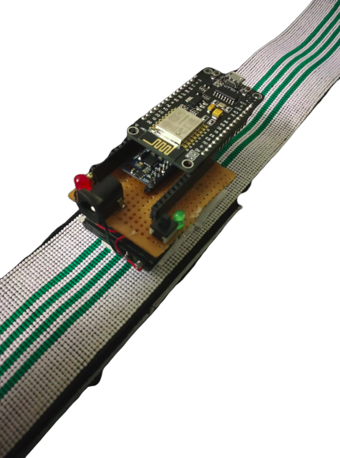
Hardware - MPU Model
Node MCU (Wifi Module)
MPU 6050
(Accelerometer)
Charging Port
Charging LED Indicator
1000 mAh Battery
Wearable Belt

Slide 17
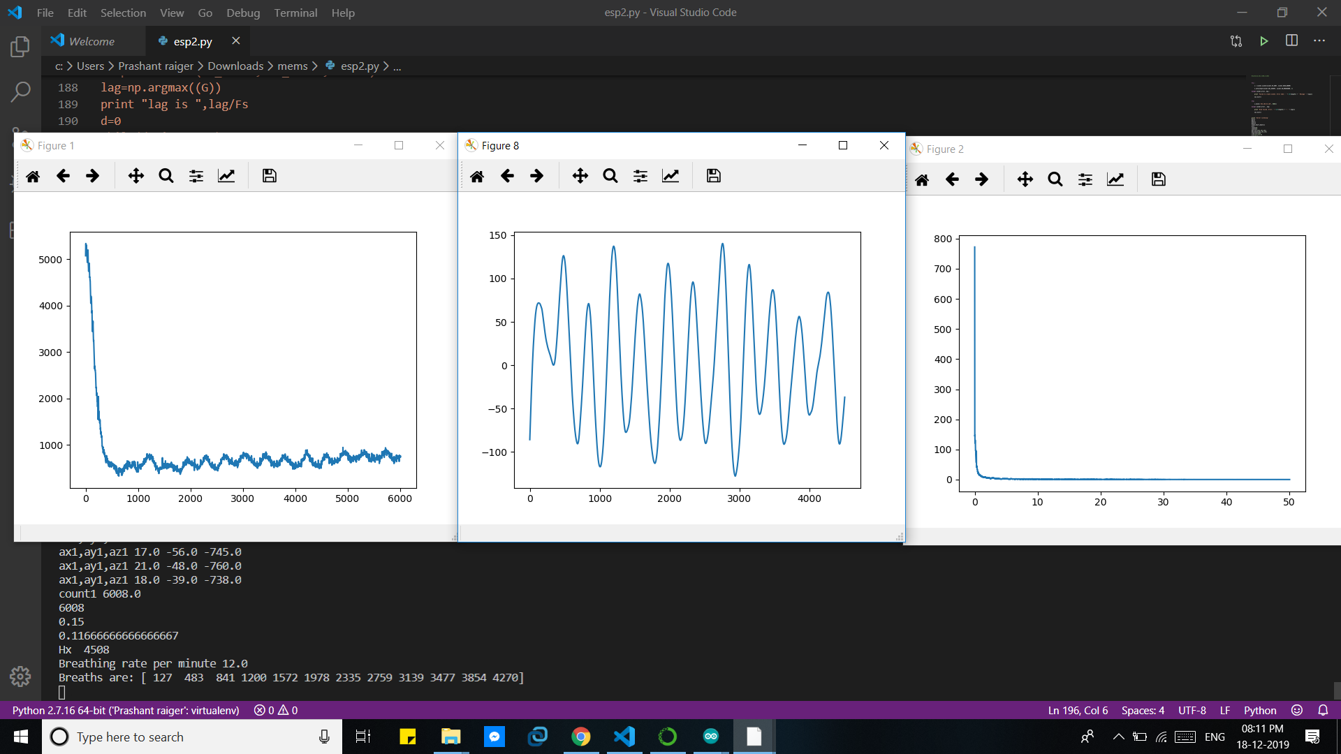
Hardware - MPU Model
Acceleration normal to chest
Filtered data

Slide 18
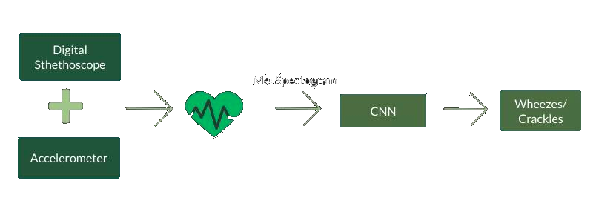
Audio Processing Unit

Slide 19
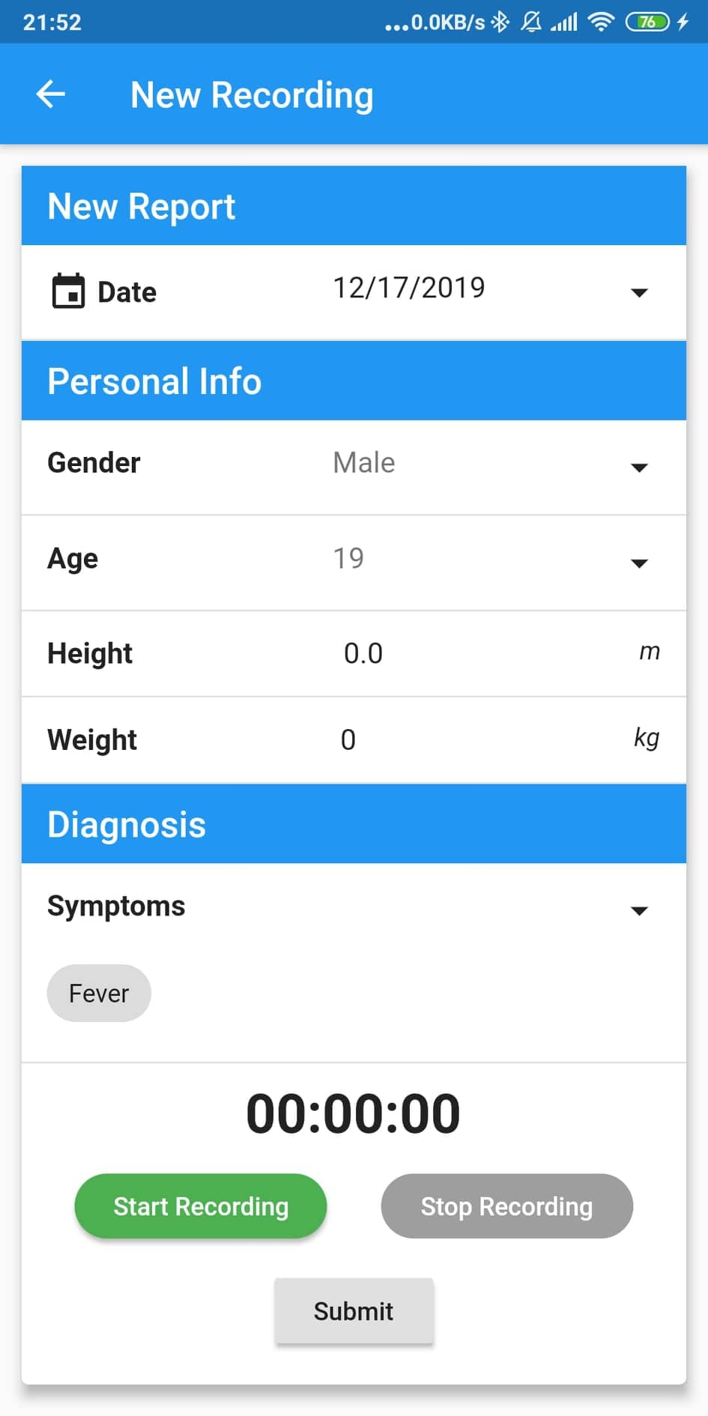
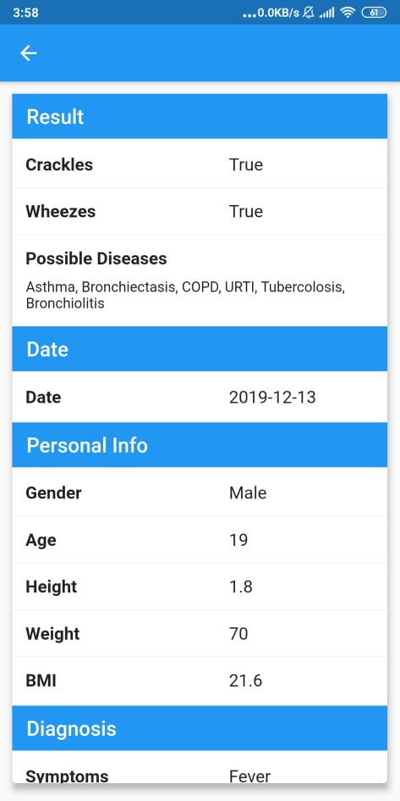
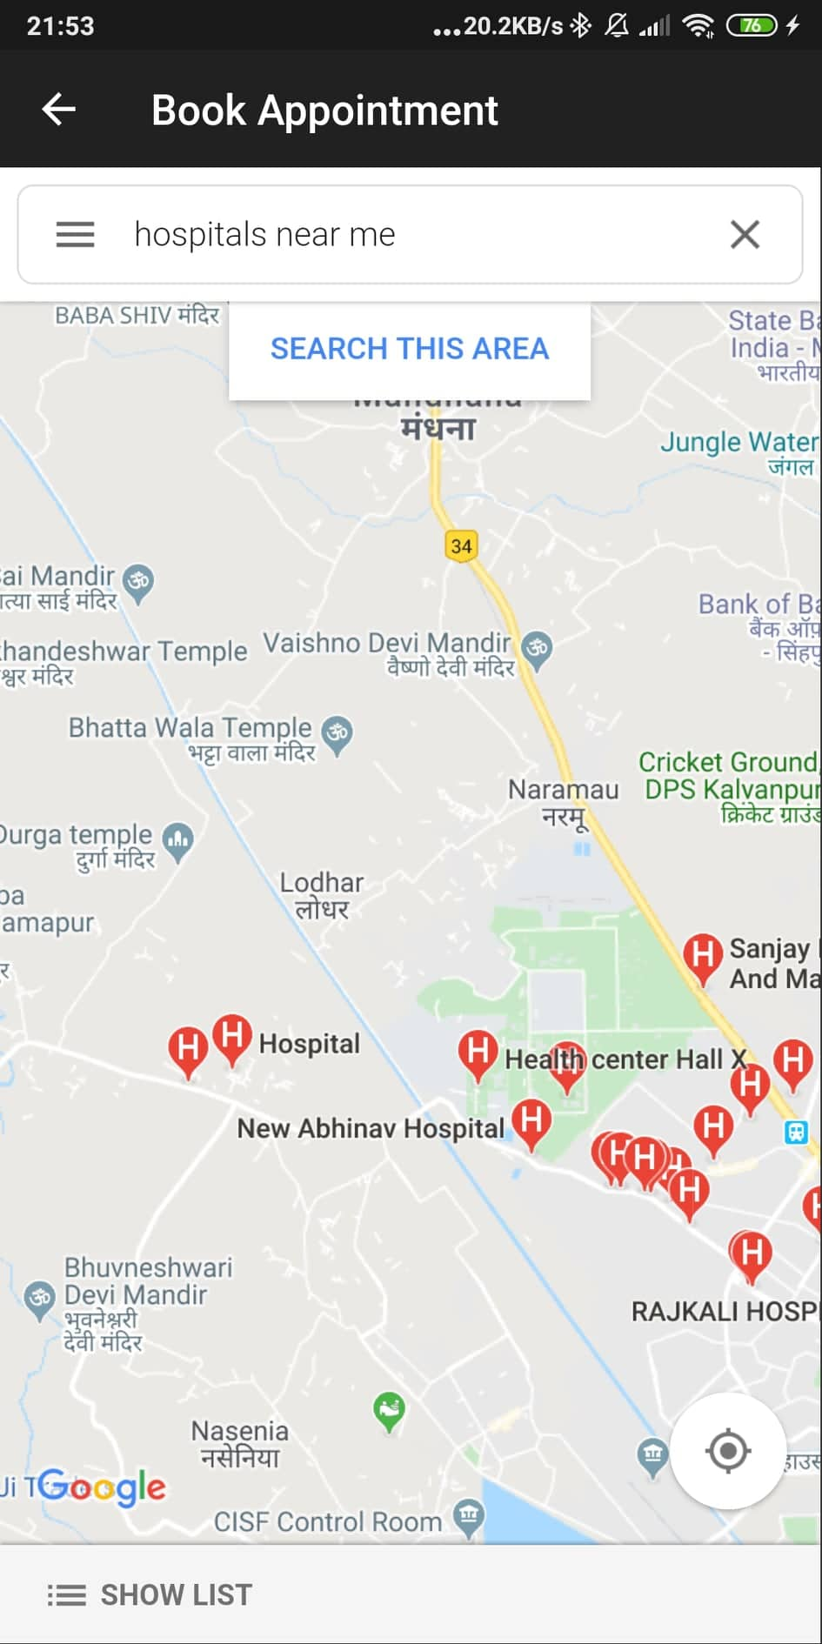
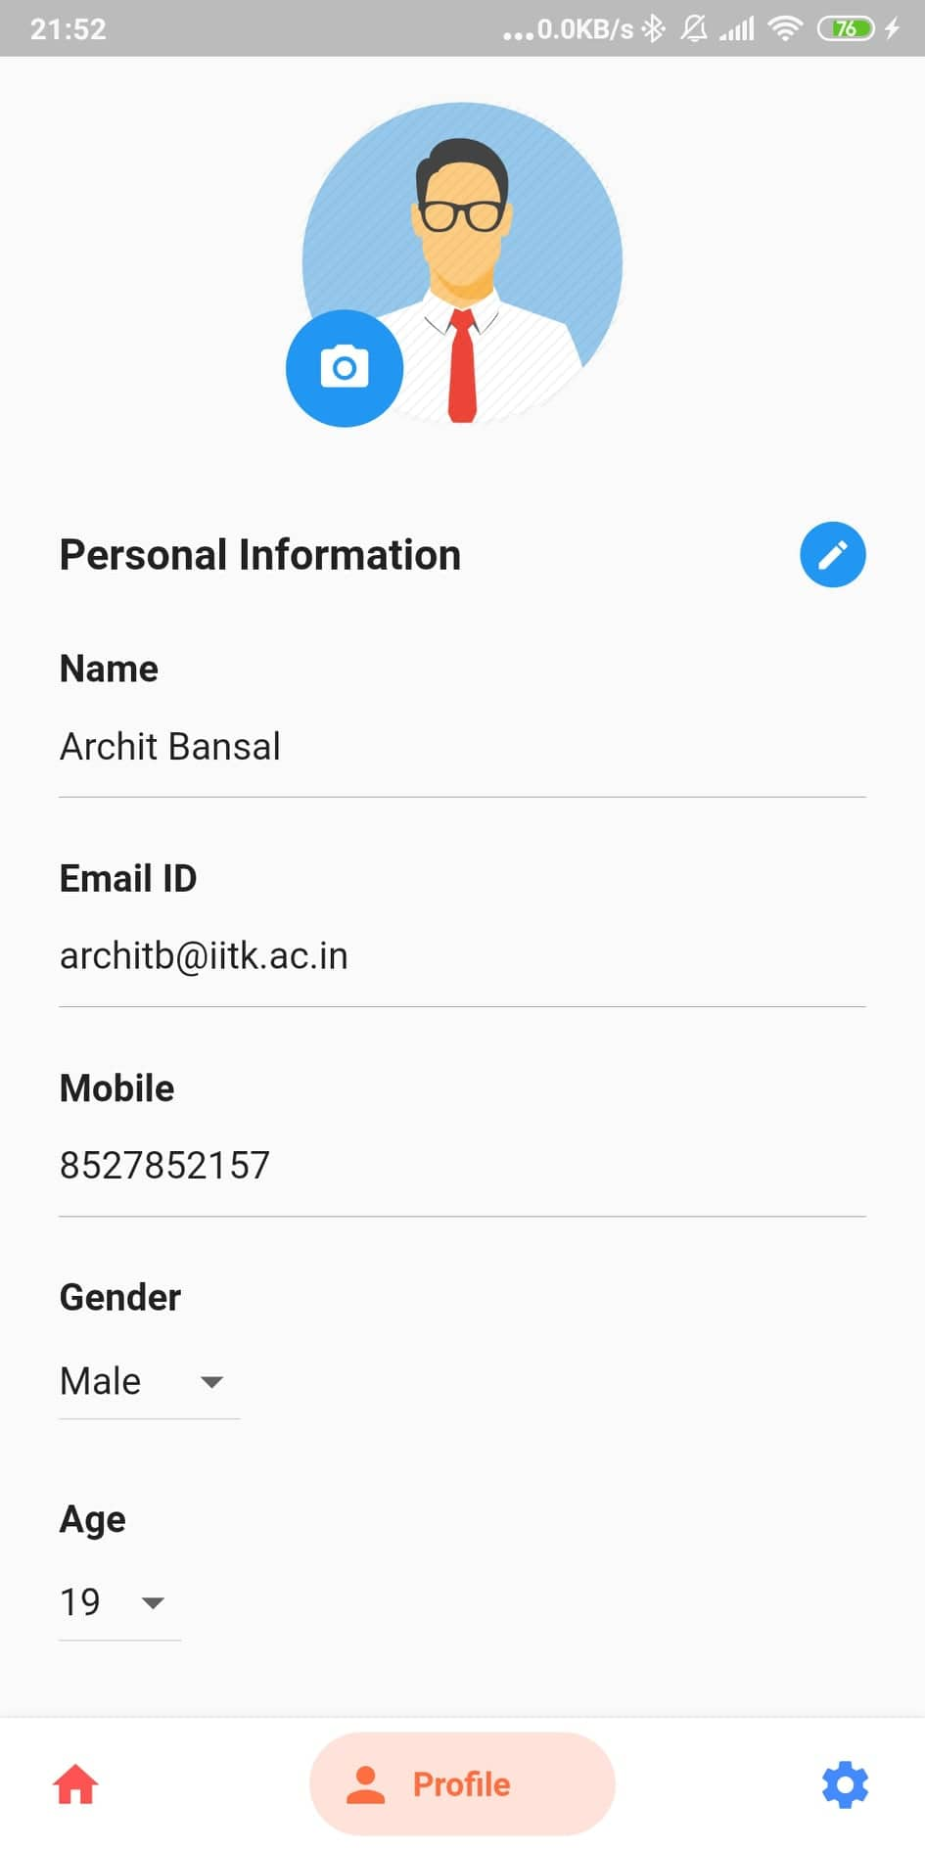
Our Application Interface

Slide 20
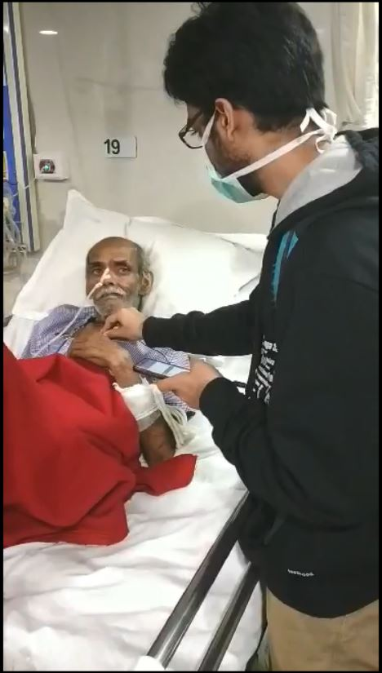
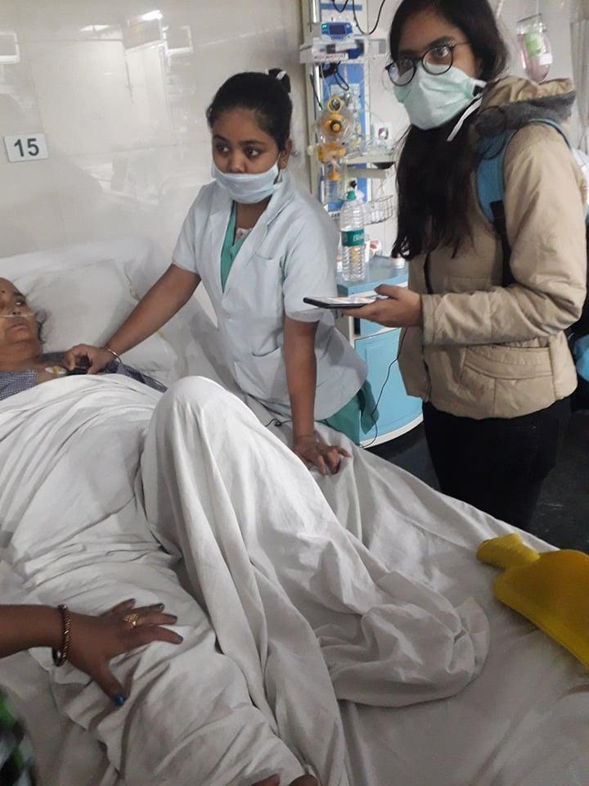
Data Collection & Validation
Health Center, IIT Kanpur
Madhuraj Private Hospital, Kanpur

Slide 21



Why Our Solution?
Uses standard, time-tested protocol followed by doctors during screening of patients.
Zero Dependence on doctors, who may have varying experience and opinions.
Uses machine learning to detect abnormal patterns in lungs sounds which human ears otherwise can not.
Reduction of a complex, experience-heavy procedure to a simple, cheap and easy-to-use.

Slide 22
Business Model

Slide 23
Business Situation Framework
01
Customer
Private Hospitals
Government
NGOs
02
Product
Nature of Product
Complimentary products
Substitutes
03
Company
Revenue Model
Cost Analysis
04
Competition
Competitors in the market
Barriers to new entrants

Slide 24
Customer
15.5K
Tier-1
Hospitals
430K
2 Lakh
Gov.
Centers
NGOs in
Healthcare
Sector
Private Hospitals
Government Services
NGOs
Private hospitals cater to the health care needs of more than 70% of Indians in both urban and rural area, and hence remain a major stakeholder in this sector.
While public sector is not the major player in the Indian healthcare system, government centres have a wider reach and cater to patients needs at more reasonable prices.
The role of NGOs in the healthcare industry is on a rise due to failure of the public sector in providing affordable treatment to all, and hence form an essential part of any model looking to tackle health issue in the rural areas.
Money minded approach
Willing to spend on new technologies like ours
TB Free India Campaign : Aims to eradicate TB from India till 2025
Allocation of Rs. 12000 crore over the next three years to fight TB
WHO targets to eradicate TB from the world by 2030
Operation ASHA : One of many NGOs working to bring the digital revolution to rural healthcare

Slide 25
Customer
15.5K
Tier-1
Hospitals
430K
2 Lakh
Gov.
Centers
NGOs in
Healthcare
Sector
Private Hospitals
Government Services
NGOs
Private hospitals cater to the health care needs of more than 70% of Indians in both urban and rural area, and hence remain a major stakeholder in this sector.
While public sector is not the major player in the Indian healthcare system, government centres have a wider reach and cater to patients needs at more reasonable prices.
The role of NGOs in the healthcare industry is on a rise due to failure of the public sector in providing affordable treatment to all, and hence form an essential part of any model looking to tackle health issue in the rural areas.
Money minded approach
Willing to spend on new technologies like ours
TB Free India Campaign : Aims to eradicate TB from India till 2025
Allocation of Rs. 12000 crore over the next three years to fight TB
WHO targets to eradicate TB from the world by 2030
Operation ASHA : One of many NGOs working to bring the digital revolution to rural healthcare

Slide 26
Customer
15.5K
Tier-1
Hospitals
430K
2 Lakh
Gov.
Centers
NGOs in
Healthcare
Sector
Private Hospitals
Government Services
NGOs
Private hospitals cater to the health care needs of more than 70% of Indians in both urban and rural area, and hence remain a major stakeholder in this sector.
While public sector is not the major player in the Indian healthcare system, government centres have a wider reach and cater to patients needs at more reasonable prices.
The role of NGOs in the healthcare industry is on a rise due to failure of the public sector in providing affordable treatment to all, and hence form an essential part of any model looking to tackle health issue in the rural areas.
Money minded approach
Willing to spend on new technologies like ours
TB Free India Campaign : Aims to eradicate TB from India till 2025
Allocation of Rs. 12000 crore over the next three years to fight TB
WHO targets to eradicate TB from the world by 2030
Operation ASHA : One of many NGOs working to bring the digital revolution to rural healthcare

Slide 27
Product
Non-Invasive Method
Caters to the needs of a large population segment
Cheap, fast and accurate
User-friendly app that can be deployed on low-end devices
Does not require trained professionals

Slide 28
Revenue & Profitability Model
Product Cost
S. No. | Component | Cost (INR)
1. | Stethoscope Chest Piece | 250
2. | Microphone | 250
3. | MPU 6050 | 150
4. | Node MCU | 135
5. | Li-ion Battery | 130
Total |  | 915
Overhead cost of production = INR 50
Selling Price of device = INR 1050
App subscription charges = INR 50 / month
Fixed Profit = INR 85 per device
Time Variable Profit = INR 50 / device / month

Slide 29
Revenue & Profitability Model
Market Share
Market Size
Market Size = 6.5 lakh health centres
Yearly Sales Target
Units Sold = Market Share x Market Size = 19.5 thousand health centers
1 per health centre
30%
Yearly App Revenue
App Revenue = INR 3.8 Million per Annum
Estimated Revenue
Revenue from sales = Selling Price of device x Numbers of units sold yearly + App Subscription Revenue
= INR 1,000 x (19,500) + (3.8 Million)
= INR 24.2 Million per Annum

Slide 30


Competitive Edge
Large amount of data collection done
Collaborative feedback from doctors

Slide 31
Social Impact

Slide 32
Would drastically reduce number of undiagnosed cases in rural areas.
Would make screening campaigns much cheaper, making them more feasible and practical for NGOs as well as the government
The DETECTB study found that such rapid diagnostic methods in Zimbabwe led to a decline in TB prevalence from 6.5 to 3.7 people per thousand.

Slide 33
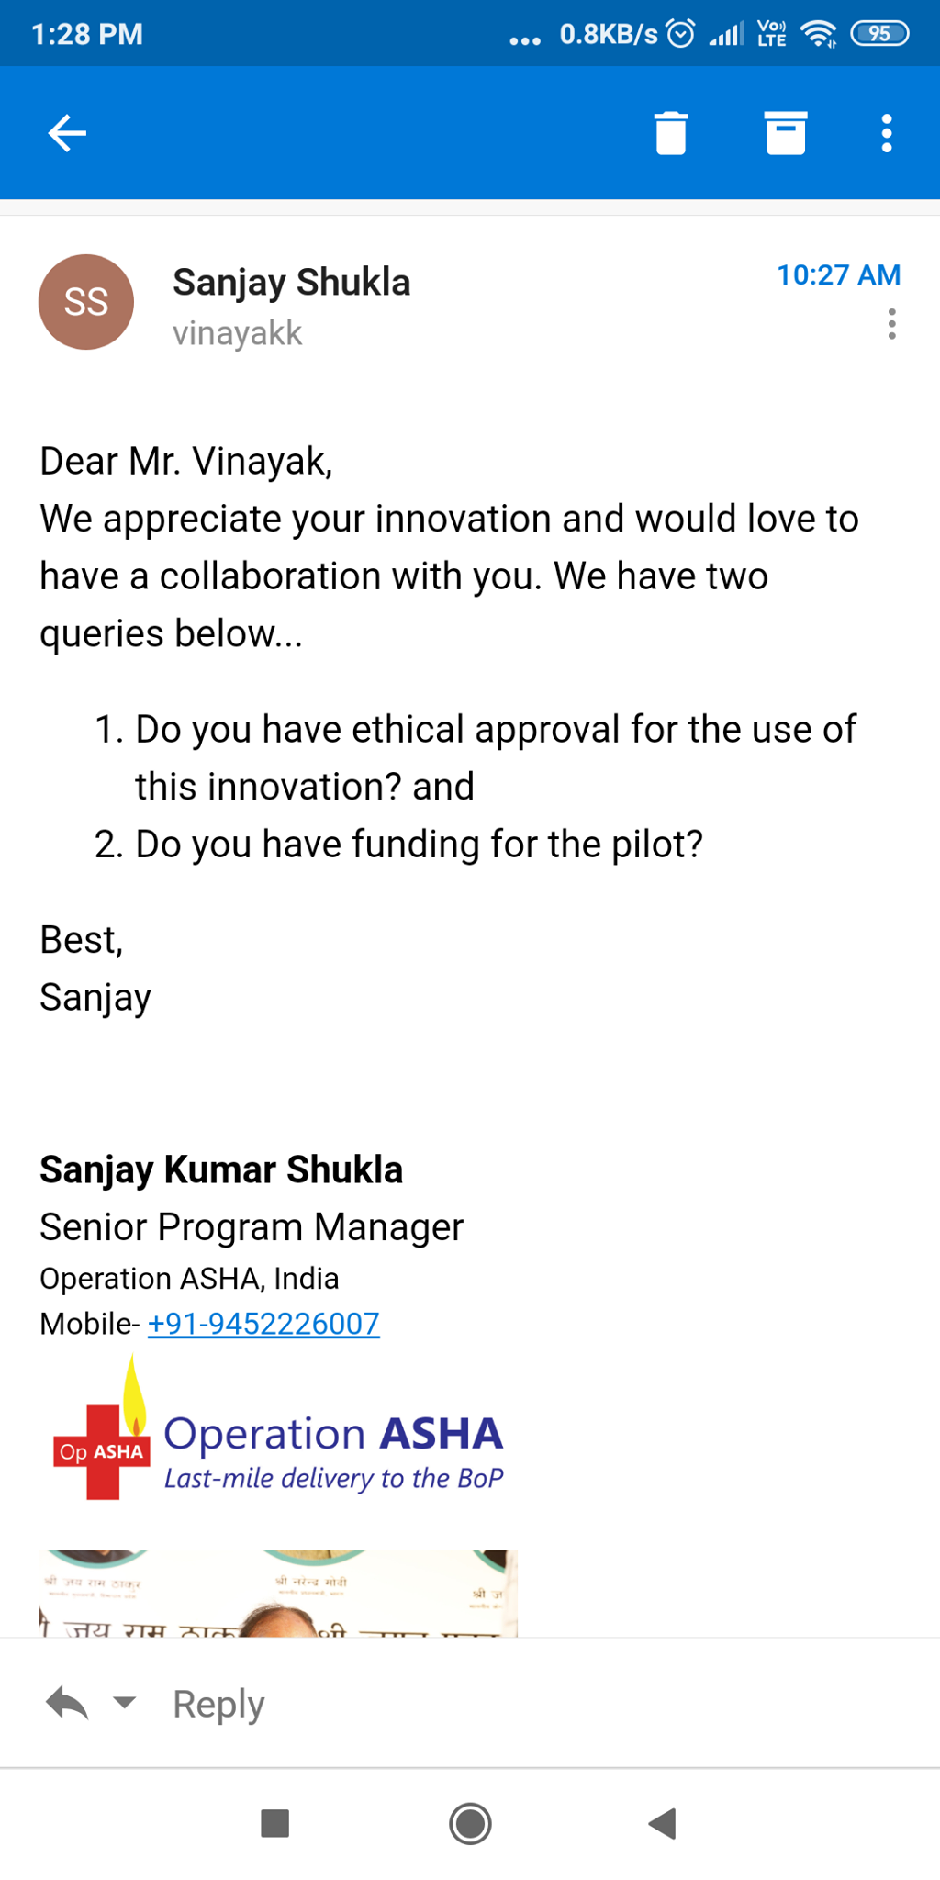
NGOs Contacted
eCompliance is a platform used by major NGOs in the healthcare sector to digitise treatment in rural and urban areas. We are planning to add our features to their platform in order to benefit large population.
Already contacted Operation ASHA, GLRA India and PSI India about our device.
Positive feedback received from Operation ASHA

Slide 34
Future Prospects

Slide 35
Scope for Improvement
Accuracy of the CNN Model can be improved by using even bigger datasets
Filters can be used to reduce noise arising from surface-diaphragm interface
CNN model can be trained for a wider variety of acoustic abnormalities, like rhonchi, rales, stridors, etc.
App can be made available in multiple languages for a linguistically diverse India.
Positively screened patients will be connected to the experienced pulmonologists.

Slide 36
Timeline
Completion of prototype and deployment at Health Center, IIT Kanpur
Field testing at nearby hospitals, feedback used to improve app
Device made available to common public and government for mass consumption
14 Nov’2019
17 Dec’2019
2021 Onwards
5 Dec’2019
2020
App and Hardware integration and abnormality prediction
Device placed in a hospital and trained over more data, field- tested for reproducibility and reliability.

Slide 37
Special Thanks To
Dr. Mamta Vyas, Chief Medical Officer, Health Center, IIT Kanpur
Dr. Dev Loomba, Director Operation, Madhuraj Hospital
Dr. Santosh K. Misra, BSBE Dept., IIT Kanpur
Mr. Pawan Kumar Mishra
Dr. Vineet Agrawal, Senior Resident, JIPMER, Pondicherry
Reference: Classification of lung sounds using convolutional neural networks

Slide 38

THANK YOU

